Slide 1
Arduino Uno
For beginners

Slide 2
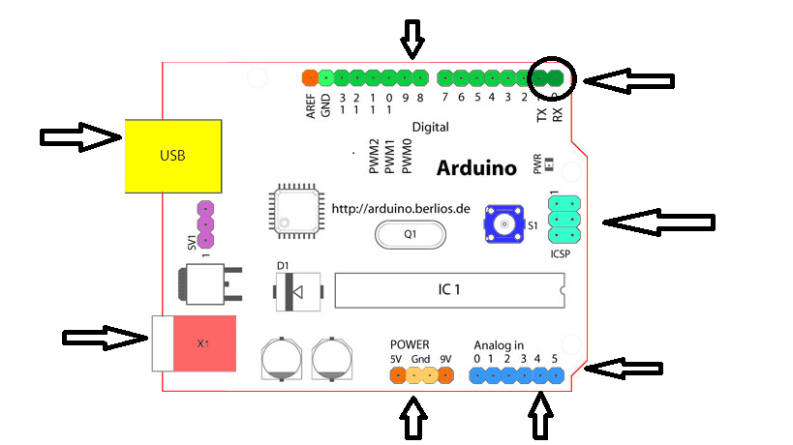
Board

Slide 3
Microcontroller
ATmega328P
14 Digital I/O Pins (of which 6 provide PWM output)
6 Analog Input Pins
40 mA per I/O pin
32 KB flash memory
2 KB SRAM

Slide 4
Digital pins
Serial: 0 (RX) and 1 (TX):Used to receive (RX) and transmit (TX) TTL serial data
External Interrupts: 2 and 3. These pins can be configured to trigger an interrupt on a low value, a rising or falling edge, or a change in value
PWM: 3, 5, 6, 9, 10, and 11. Provide 8-bit PWM output
** BT Reset: 7Connected to the reset line of the bluetooth module
LED: 13.built-in LED connected to digital pin 13

Slide 5
Analog Pins
10 bit ADC
Step=vref/1024
analog inputs can also be used as digital pins
14 -19

Slide 6
How to program
void setup()
void loop()

Slide 7
How to program-setup() method
Initializes all features required
Invoked only in startup
pinMode(pin,INPUT/OUTPUT)-to specify function of input
eg:pinMode(3,INPUT);
To configure serial communications
eg: Serial.begin(rate)

Slide 8
How to program-loop() method
To specify “what to do with input and output”
Loops until it is off
Be careful while writing this method

Slide 9
How to program-input
Simple form of input is the digital one ie 0 or 1
We use “int digitalRead(pin)” to this
eg:digitalRead(3);

Slide 10
How to program-input
Analog value is represented by 10 bits
The voltage varies between 0-5v
We use “int analogRead(pin)” for reading analog input
Here pin takes values A0-A5
eg: int in=analogRead(A3);

Slide 11
How to program-input
To read digital input from A0-A5
Simply use digitalRead()
But the pin number is 14 for A0 and 19 for A5

Slide 12
How to program-output
Simple digital out put can be generated by digitalWrite(pin,HIGH/LOW)
eg: digitalWrite(13,HIGH)

Slide 13
Need for delay
The microcontroller works with 4MHz
So the operations are much faster
Inorder to recognize the I/O we must provide some delay
We use “delay(count)” for providing delay in Arduino
The total delay=count ms

Slide 14
Lets begin
void setup(){
pinMode(13,OUTPUT);
}
void loop(){
digitalWrite(13,HIGH);
delay(500);
digitalWrite(13,LOW);
delay(500);
}

